Slide 1
Montgomery College New Science Center
Energy Efficient System Design:
Geothermal System Coupled with Chilled Beams and DOAS

Slide 2
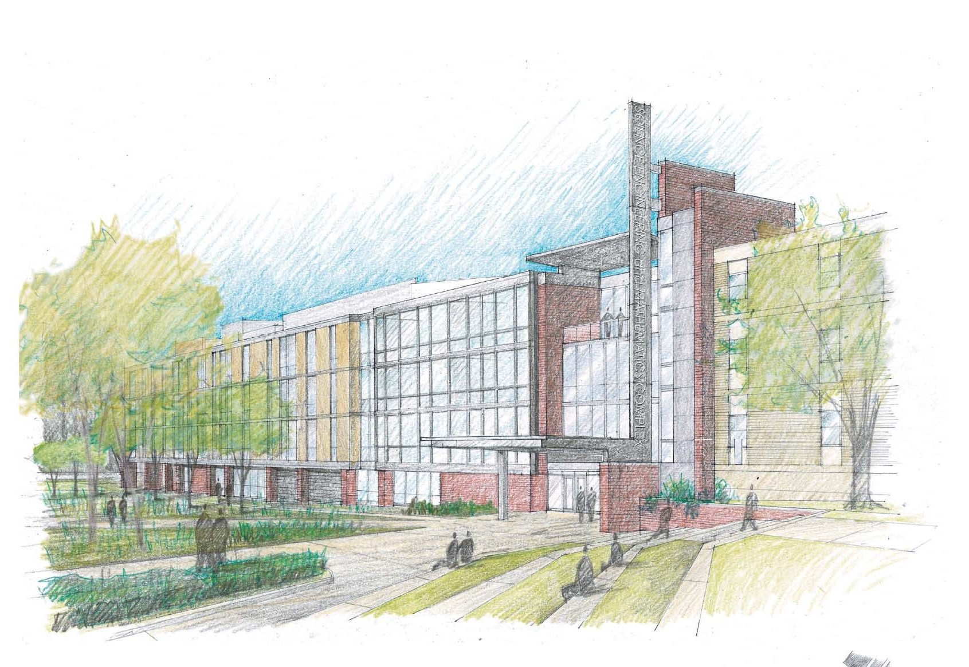
Presentation Material:
Building Overview
Redesign Goals
Current Mechanical System
Mechanical System Redesign
Lighting Redesign
Acoustic Impact
Energy Savings
Cost Analysis
Conclusions

Slide 3
Presentation Material:
Located on Montgomery College Rockville Maryland Campus
Four Stories
140,700 Square Feet
Direct Addition to Science East
Bridge Connected to Science West
Consists of Laboratories, Classrooms, and Offices
Four Story Atrium
Roof Observatory with power switch sliding roof
Exterior Amphitheatre
Water Retention Pond
Building Overview
Redesign Goals
Current Mechanical System
Mechanical System Redesign
Lighting Redesign
Acoustic Impact
Energy Savings
Cost Analysis
Conclusions

Slide 4
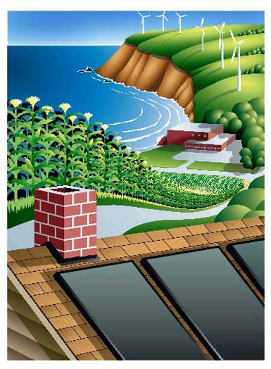
Presentation Material:
System Redesign Goals:
Energy Efficiency
Environmental Impact
Building Overview
Redesign Goals
Current Mechanical System
Mechanical System Redesign
Lighting Redesign
Acoustic Impact
Energy Savings
Cost Analysis
Conclusions
Original Design Goals:
Energy Efficiency
Control Laboratory Contaminants
Anticipated Expansion

Slide 5
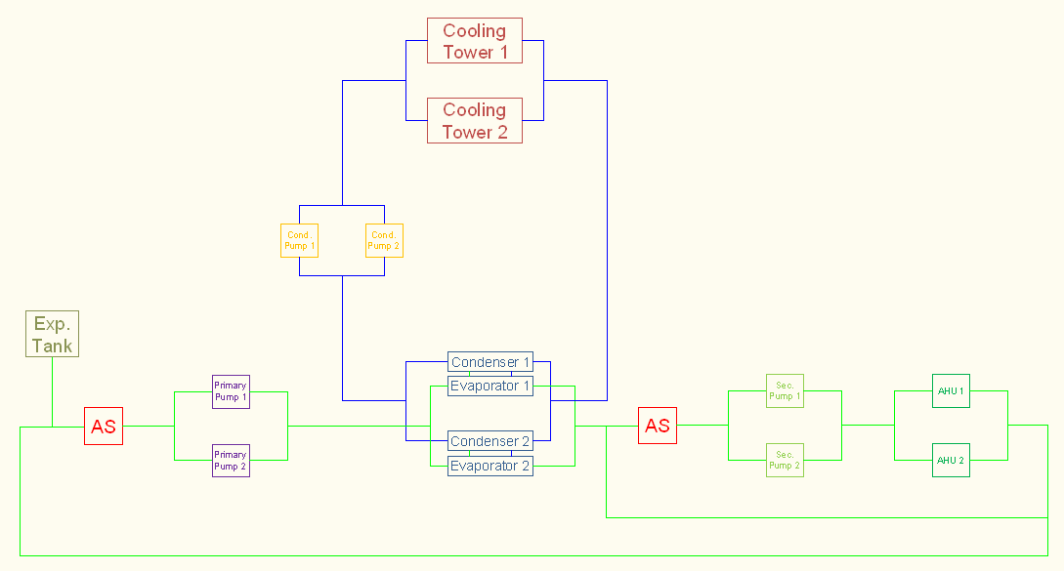
Current Central Chilled Water System:
System in Place:
  225 Ton Chillers with VFD
  Cooling Tower
  Two Condenser Pumps
Original New Design:
  Two 305 Ton Centrifugal Chillers
  Two induced draft-cross flow Cooling Towers arranged to share a basin with VFDs
  Two Primary & Secondary Pumps with VFDs
Building Overview
Redesign Goals
Current Mechanical System
Mechanical System Redesign
Lighting Redesign
Acoustic Impact
Energy Savings
Cost Analysis
Conclusions

Slide 6
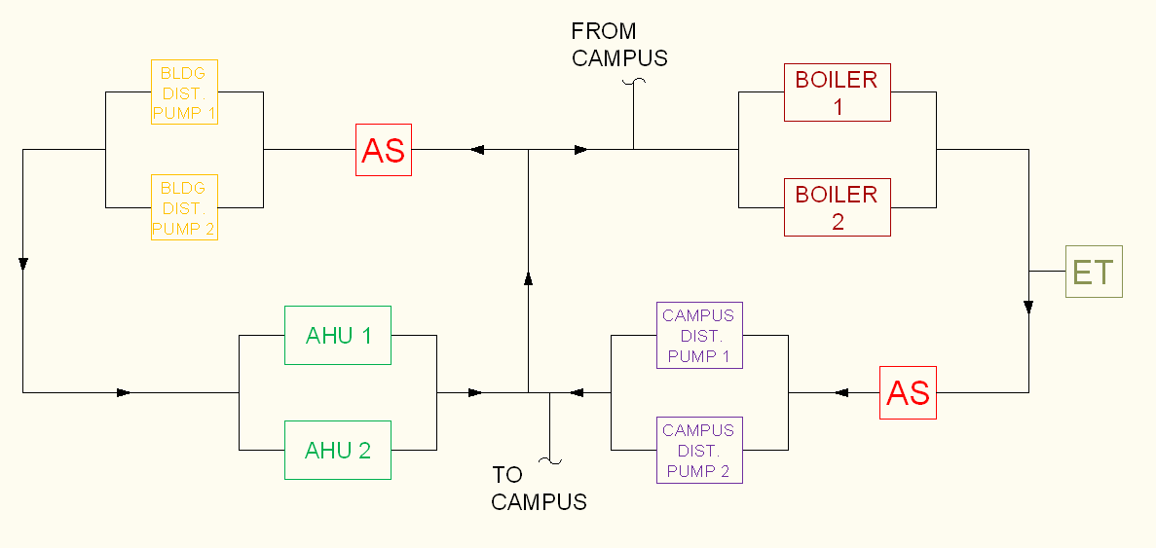
Current Central Hot Water System:
Two 3 Million BTU 87% operating efficiency Boilers
  Two Distribution & Campus Distribution Pumps
  No Boiler Pumps
Building Overview
Redesign Goals
Current Mechanical System
Mechanical System Redesign
Lighting Redesign
Acoustic Impact
Energy Savings
Cost Analysis
Conclusions

Slide 7
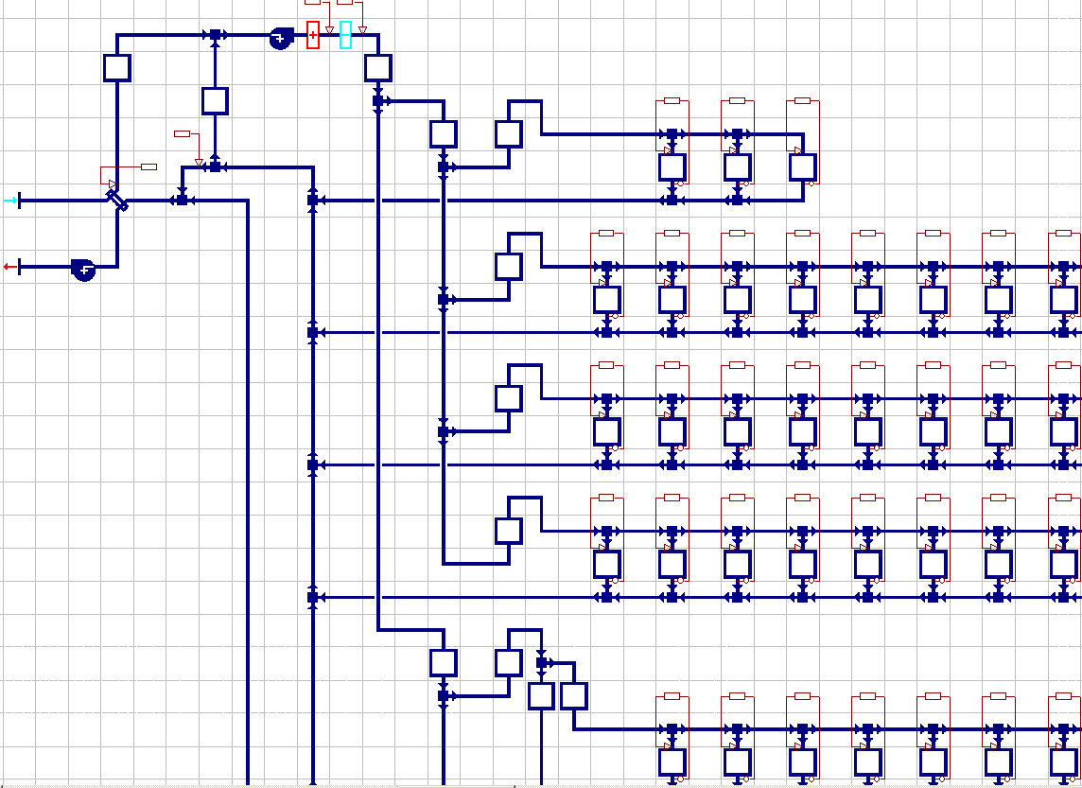
Current Central Air Handling System:
  Two VAV Rooftop Units manifolded together by a common discharge plenum
    Dual Supply Fans
    Isolation Dampers to isolate one unit from the rest of the system
    No Return Fan
    Return Air Damper maintains building pressure
    Heating and Cooling Coils
    Heat Recovery Coil
  Local Reheat Coils at Rooms
Building Overview
Redesign Goals
Current Mechanical System
Mechanical System Redesign
Lighting Redesign
Acoustic Impact
Energy Savings
Cost Analysis
Conclusions
Notes:
The only relief is required during economizer mode. This relief will be discharged from the building through the smoke exhaust fans

Slide 8
Current Central Exhaust System:
Four high plume Exhaust Fans connected by common plenum
  Maintain Negative pressure in the Exhaust Plenum and Laboratories
  Constant Volume/fan; Variable Volume for the building
    Make-up Air Damper in Exhaust Plenum to maintain a constant exhaust flow rate
    Dampers within plenum normally open that maintains remote duct static pressure
Building Overview
Redesign Goals
Current Mechanical System
Mechanical System Redesign
Lighting Redesign
Acoustic Impact
Energy Savings
Cost Analysis
Conclusions
Notes:
When the amount of make-up air exceeds the design flow rate through one whole fan, the exhaust fan with the longest run time shall shut off and the amount of make-up air will be varied accordingly to maintain a constant flow of exhaust air through the rest of the fans in operation fans.

Slide 9
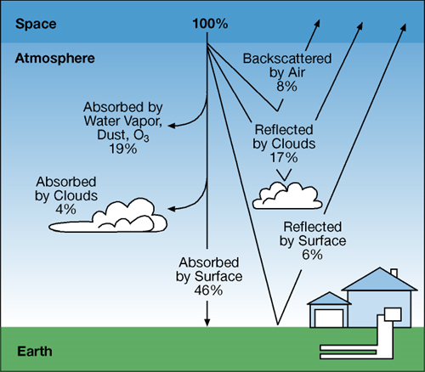
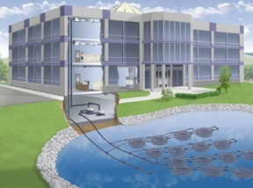
Geothermal Systems:
Earth’s solar energy is absorbed into the ground in the form of heat energy
Open loop systems use a water source as the heat sink
Closed loop systems use the constant ground temperature as a heat sink
Moves Heat Energy
Utilizes a heat sink to take or expel heat energy
Open and closed loop system types
Building Overview
Redesign Goals
Current Mechanical System
Mechanical System Redesign
Lighting Redesign
Acoustic Impact
Energy Savings
Cost Analysis
Conclusions

Slide 10
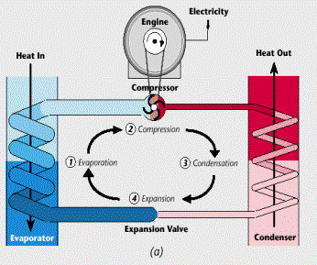
Geothermal Systems:
Transfers energy between the heat sink and the building
Works in place of a the cooling tower & boiler in a typical HVAC system
Variable flow is ideal to decrease the pumping power
Reduces the amount of electricity & fossil fuel needed
Building Overview
Redesign Goals
Current Mechanical System
Mechanical System Redesign
Lighting Redesign
Acoustic Impact
Energy Savings
Cost Analysis
Conclusions

Slide 11
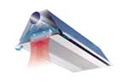
Chilled Beams:
Passive chilled beams induce current through natural convection
  Air passes over cooled coils and drops into the room
  Warm air rises into the beam to be cooled and then redistributed into the room
Low investment costs
High Cooling Capacities
Available as passive or active
Coupled with a geothermal system: become a water- to – water system , increasing the energy efficiency
Recessed in or hung from the ceiling in place of a diffuser
Water pumped to the chilled beam in the room to cool the air locally
Allows the HVAC system to decouple the ventilation and the humidity requirements from the sensible heating and cooling requirements
Building Overview
Redesign Goals
Current Mechanical System
Mechanical System Redesign
Lighting Redesign
Acoustic Impact
Energy Savings
Cost Analysis
Conclusions
Active chilled beams provide ventilation air through small air jets in addition to the induced air flow
  Natural convection and ventilation air induce airflow over the coils
  Air is then cooled and diffused into the room
  Possible noise problems
Notes:
The combination of the natural convection and forced air increases the effect of the natural convection. The increased effect allows the system to have higher heating and cooling capacities over the passive chilled beam.

Slide 12
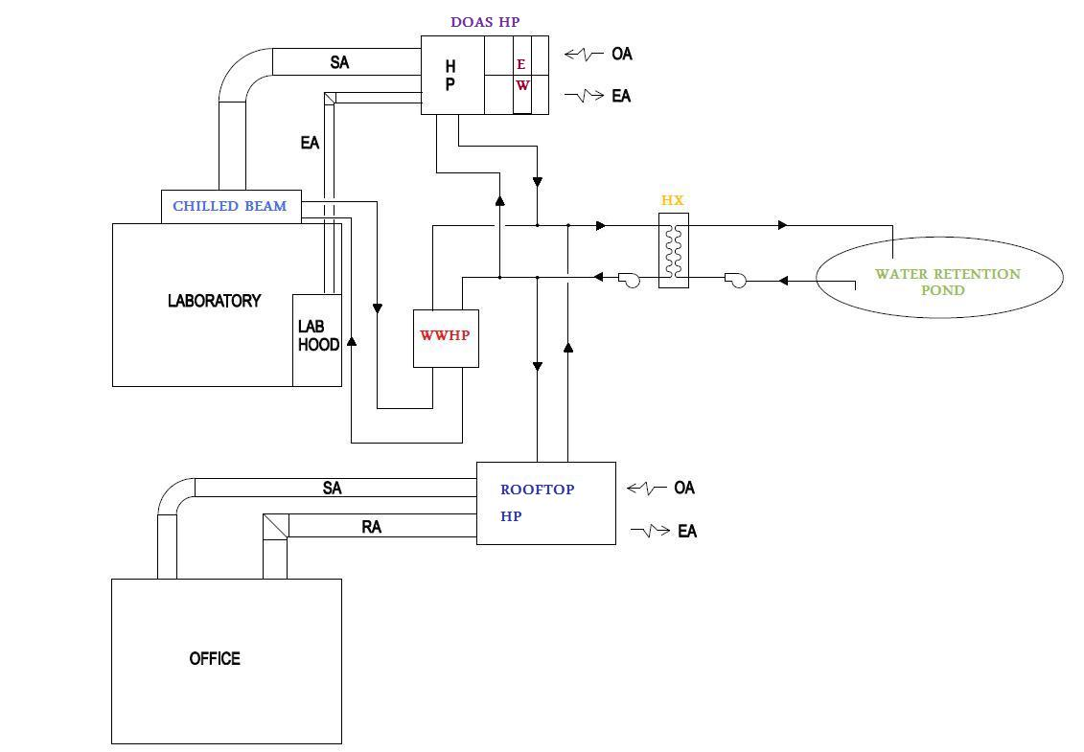
Laboratory and Classroom Mechanical System Redesign:
Labs/CB WW Heat Pumps | MBH | TONS | UNIT MBH | # OF UNITS | COP | EER | GPM
Heating | 1,399 | 117 | 350 | 4 | 4.08 | 13.92 | 84
Cooling | 1,071 | 89 | 393 | 3 | 5.22 | 17.80 | 84
Replaces the original boilers, chillers, and cooling towers, with water to water heat pumps and water to air heat pumps.
Four water to water heat pumps are provided for the laboratories and classrooms
One additional water to water heat pump for redundancy and simultaneous heating and cooling conditions
The water is supplied to and from the pond to a heat exchanger
The geothermal system acts like a closed loop system taking water to and from the heat exchanger to the water to water heat pump
The water to water heat pump water is distributed to the variable flow active chilled beams
Building Overview
Redesign Goals
Current Mechanical System
Mechanical System Redesign
Lighting Redesign
Acoustic Impact
Energy Savings
Cost Analysis
Conclusions

Slide 13
Laboratory and Classroom Mechanical System Redesign:
Lab/CB DOAS HP | MBH | TONS | CFM | UNIT MBH | # OF UNITS | UNIT CFM | # OF UNITS | COP | EER
Heating | 1,203 | 100 | 101,255 | 406 | 3 | 12,400 | 9 | 4.30 | 14.67
Cooling | 8,154 | 680 | 101,255 | 916 | 9 | 12,400 | 9 | 5.33 | 18.20
The heat exchanger that transfers the heat energy from the water retention pond, supplies the water to the DOAS heat pump
Ventilation air is supplied to the laboratory and classroom active chilled beams by the DOAS heat pump
The DOAS heat pump provides any necessary dehumidification
The water is condensed out of the air until 55% RH is reached and then reheated
All air from the laboratories is exhausted from the building after passing over the enthalpy wheel
Building Overview
Redesign Goals
Current Mechanical System
Mechanical System Redesign
Lighting Redesign
Acoustic Impact
Energy Savings
Cost Analysis
Conclusions

Slide 14
Office Mechanical System Redesign:
Office Rooftop HP | BTUH | TONS | CFM | UNIT MBH | # OF UNITS | UNIT CFM | # OF UNITS | COP | EER
Heating | 196,521 | 16 | 15,627 | 181 | 2 | 8,000 | 2 | 3.40 | 11.60
Cooling | 405,640 | 34 | 15,627 | 237 | 2 | 8,000 | 2 | 4.25 | 14.50
Water is supplied from the heat exchanger to the rooftop heat pump where the heat energy is transferred to the air that is then supplied to the offices
The rooftop heat pump supplies air to the offices at 52⁰F through a VAV box and reheat coil
  The water for the reheat coils is provided by the water-to-water heat pumps
Air is returned from the offices to the rooftop heat pump decrease the amount of air conditioning
Dehumidification is completed in the rooftop heat pump similar to the DOAS heat pump but without the help of the enthalpy wheel
Building Overview
Redesign Goals
Current Mechanical System
Mechanical System Redesign
Lighting Redesign
Acoustic Impact
Energy Savings
Cost Analysis
Conclusions

Slide 15
Open Loop Geothermal System Redesign:
Water from the water to water heat pumps, rooftop heat pumps, and DOAS heat pumps is returned back to the heat exchanger.
During the cooling season:
  The systems returned water transfers the heat energy through the heat exchanger back to the water retention pond
  After the heat is rejected it is re-circulated into the system to continue the process
During the heating season :
  The systems returned water absorbs energy from through the heat exchanger from the water retention pond
  After the heat is absorbed into the system, the water pumped back to the water retention pond
Building Overview
Redesign Goals
Current Mechanical System
Mechanical System Redesign
Lighting Redesign
Acoustic Impact
Energy Savings
Cost Analysis
Conclusions

Slide 16
Energy Efficient Replacement Fixtures:
 | Heating (boilers etc.) | Cooling (chillers etc.) | Fans, pumps and controls | Lights | Equip.
Lighting Redesign | 8445.139 | 13749.672 | 310949.906 | 1247.095 | 4773.785
Original Lighting | 8406.94 | 13885.029 | 310998.094 | 1432.732 | 4773.785
Building Overview
Redesign Goals
Current Mechanical System
Mechanical System Redesign
Lighting Redesign
Acoustic Impact
Energy Savings
Cost Analysis
Conclusions
Earth Friendly Troffers
  Up to 88% efficiency
  Recessed 2’x4’
  Power Density: 0.7 W/ft²
  Highly reflective matte white power coating
  Engineered louvers
  3” Baffle element that illuminates while reducing glare
  Occupancy Sensors

Slide 17
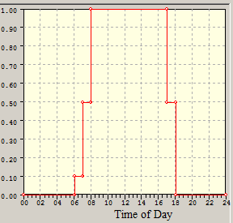
Lightings Schedules within IES Model:
  Occupancy Type
  Anticipated Typical Weekday Usage
  Anticipated Typical Weekend Usage
Building Overview
Redesign Goals
Current Mechanical System
Mechanical System Redesign
Lighting Redesign
Acoustic Impact
Energy Savings
Cost Analysis
Conclusions
Office Weekday Lighting Schedule

Slide 18
Lighting Redesign Energy Savings:
Savings in:
Illuminance Energy
Cooling Energy and Load
HVAC Equipment Energy and Load
Building Overview
Redesign Goals
Current Mechanical System
Mechanical System Redesign
Lighting Redesign
Acoustic Impact
Energy Savings
Cost Analysis
Conclusions

Slide 19
Room Reverberation Time:
Original Acoustical Design
Classrooms, Laboratories, and Offices should have a reverberation time between 0.7 and 1.1 seconds
ROOM | T60 at 500 HZ | T60 at 1000 HZ
Classroom | 0.66 seconds | 0.65seconds
Laboratory | 0.66 seconds | 0.65 seconds
Office | 0.46 seconds | 0.34 seconds
Building Overview
Redesign Goals
Current Mechanical System
Mechanical System Redesign
Lighting Redesign
Acoustic Impact
Energy Savings
Cost Analysis
Conclusions
Recommendations:
Some of the walls changed from the single layer of gypsum board to a double layer
Acoustical Ceiling Tile replaced with Armstrong Suspended Ceiling
Carpet in Offices changed to Epoxy Terrazzo
Light decorative Velour added to Large Offices
Recommended Acoustical Design
ROOM | T60 at 500 HZ | T60 at 1000 HZ
Classroom | 0.77 seconds | 0.70 seconds
Laboratory | 0.78 seconds | 0.70 seconds
Office | 0.73 seconds | 0.71 seconds

Slide 20
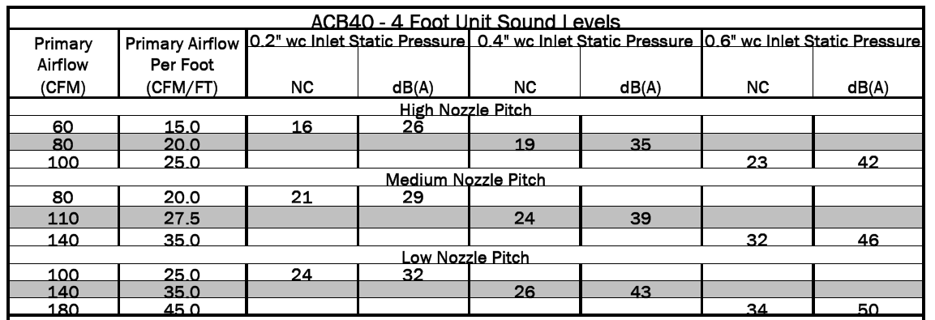
Chilled Beam Acoustics:
 | NC Rating
Classrooms | 25-30
Laboratories | 35-40
Private Offices | 30-35
Static Pressure should never exceed 0.4” w.c.
Classrooms and offices need less ventilation air than the laboratories and therefore have smaller flow rates
Building Overview
Redesign Goals
Current Mechanical System
Mechanical System Redesign
Lighting Redesign
Acoustic Impact
Energy Savings
Cost Analysis
Conclusions

Slide 21
Energy Savings:
27.75% Energy Savings over the original design
energy required for the heat pumps is about half the energy needed for the boilers and chillers
Needed Reheat was reduced almost 90%
Lighting energy was reduced by the lighting redesign
Saves 2,342,986 kilowatts a year
Redesign |  |  | Original Design
System Component | MMBTU | kwh | MMBTU | kwh | System Component
Nat gas | 88 | 25,674 | 5,726 | 1,678,087 | Fans, Controls, Plug, Misc.
Electricity | 5,404 | 1,583,702
Chilled Beam HP (heating) | 507 | 148,496 | 9,239 | 2,707,802 | Direct Acting Heater
Office Reheat | 488 | 142,947
Chilled Beam HP (cooling) | 953 | 279,242 | 7,273 | 2,131,514 | Boilers and Chillers
DOAS HP | 2,037 | 596,999
Office Heat Pump | 546 | 159,962
Pumps | 9,548 | 2,798,240 | 5,142 | 1,506,947 | Pumps
Lights | 1,248 | 365,797 | 1432 | 419,695 | Lights
Total energy | 20,817 | 6,101,060 | 28,811 | 8,444,045 | Total Original Energy
Building Overview
Redesign Goals
Current Mechanical System
Mechanical System Redesign
Lighting Redesign
Acoustic Impact
Energy Savings
Cost Analysis
Conclusions

Slide 22
Energy Savings:
Original System Design
 | MMBTU | therms | $1.54/therm
boilers | 2,949 | 29,493 | $45,419.11
Total Natural Gas | 2,949 | 29,493 | $45,419.11
 | MMBTU | kwh | $0.1321/kwh
chillers | 4,324 | 1,267,280 | $167,407.66
direct acting heaters | 9,239 | 2,707,690 | $357,685.87
fan | 3,617 | 1,060,092 | $140,038.12
pump | 5,142 | 1,506,884 | $199,059.40
equipment | 2,108 | 617,925 | $81,627.95
Lights | 1,433 | 419,896 | $55,468.24
Total Electric | 25,863 | 7,579,767 | $1,001,287.24
Total Energy Cost |  |  | $1,046,706.36
System Redesign
 | MMBTU | therms | $1.54/therm
Nat gas | 88 | 876 | $1,349.33
 | MMBTU | kwh | $0.1321/kwh
Electricity | 5,404 | 1,583,702 | $209,207.06
Chilled Beam HP (heating) | 507 | 148,496 | $19,616.27
Office Reheat | 488 | 142,947 | $18,883.34
Chilled Beam HP (cooling) | 953 | 279,242 | $36,887.90
DOAS HP | 2,037 | 596,999 | $78,863.56
Office Heat Pump | 546 | 159,962 | $21,131.01
Pumps | 9,548 | 2,798,240 | $369,647.55
Lights | 1,248 | 365,797 | $48,321.81
Total energy | 20,817 | 6,076,262 | $803,907.83
Total Energy Cost |  |  | $805,257.16
Energy Rates:
$1.54 per therm
$0.1321 per kilowatt hour
Comparison:
Original design: $1,406,706/yr
  Majority of cost is attributed to direct acting heaters due to local reheat
Redesign: $805,257/yr
  Majority of cost is attributed to the pumps since the system is predominately hydronic
Resultant Savings: $601,449/yr from original design
            $1,148,501/ yr from the Baseline
Redesign saves 42.76% over the original design
Building Overview
Redesign Goals
Current Mechanical System
Mechanical System Redesign
Lighting Redesign
Acoustic Impact
Energy Savings
Cost Analysis
Conclusions

Slide 23
LEED Assessment:
Category | Points Anticipated | Possible Points
Sustainable Site | 8 | 14
Water Efficiency | 3 | 5
Energy and Atmosphere | 12 | 17
Materials and Resources | 4 | 13
Indoor Environmental Quality | 13 | 15
Innovation and Design | 2 | 5
Total | 42 | 69
Increased the Energy and Atmosphere Category by 2 point
Gained the 2 points in the Optimize Energy Performance Credit
  Increase the credit from 8/10 points to 10/10 points available
  The Original Design was an estimated 28% energy cost savings over the ASHRAE 90.1 Baseline Building
  35% Energy Savings must be reached to receive 10 out of 10 of the Optimize Energy Performance Credit
  The Redesign is an estimated 58.78% energy cost savings over the ASHRAE 90.1 Baseline Building
  This would most likely qualify for an additional Innovation and Design Credit
Building Overview
Redesign Goals
Current Mechanical System
Mechanical System Redesign
Lighting Redesign
Acoustic Impact
Energy Savings
Cost Analysis
Conclusions
Category | Points Anticipated | Possible Points
Sustainable Site | 8 | 14
Water Efficiency | 3 | 5
Energy and Atmosphere | 14 | 17
Materials and Resources | 4 | 13
Indoor Environmental Quality | 13 | 15
Innovation and Design | 2 | 5
Total | 44 | 69

Slide 24
Initial Cost Comparison:
DOAS HP | $446,400.00
ROOFTOP HP | $64,000.00
WATER TO WATER HP | $134,750.00
CHILLED BEAMS | $267,300.00
HEAT EXCHANGER | $7,500.00
PIPING | $1,909,880.00
LOOP PIPING | $96,000.00
PUMPS | $55,200.00
DUCTWORK | $3,110,880.08
AIR VALVES | $4,563,000.00
VAV BOXES | $144,000.00
CONTROLS | $1,441,300.00
TESTING AND BALANCING | $588,030.00
HVAC COSTS: | $12,828,240.08
Original Design HVAC Initial Cost: $10,332,198
  $73.43/ square foot
Redesign HVAC Initial Cost: $12,828240
    $91.17/ square foot
Increased Cost: $2,496,042
It would take 4.15 years for the energy savings to overcome the increased initial costs of the redesigned system over the original design
Anticipated Payback Period: 11.17 years
Building Overview
Redesign Goals
Current Mechanical System
Mechanical System Redesign
Lighting Redesign
Acoustic Impact
Energy Savings
Cost Analysis
Conclusions

Slide 25
Redesigned System Conclusions:
Redesign was found to be over 27% more energy efficient than the original mechanical system design.
This energy savings result in approximately $600,000 a year.
The initial cost of the redesigned system was estimated to cost $2.5 million more.
Therefore the payback for the new system compared to the original design would take slightly over four years.
Payback period of 11.17 years
The system redesign may not be a favorable alternative to the original design due to significant increase in the initial cost.
Building Overview
Redesign Goals
Current Mechanical System
Mechanical System Redesign
Lighting Redesign
Acoustic Impact
Energy Savings
Cost Analysis
Conclusions

Slide 26
Acknowledgements:
Thesis Advisor | Dr. James Freihaut
BurtHill Engineers | Jonathon Gridley Tom Hovan, PE Dustin Eplee Matt Rooke Kevin McCormick PE
Penn State Professors | Dr. William Bahnfleth Dr. Moses Ling
Parents | Atty. Tim Leventry Ruth Leventry
Building Overview
Redesign Goals
Current Mechanical System
Mechanical System Redesign
Lighting Redesign
Acoustic Impact
Energy Savings
Cost Analysis
Conclusions
Questions?

